Slide 1


Functions and Function Expressions
Closures, Function Scope, Nested Functions
Telerik Software Academy
Learning & Development Team
http://academy.telerik.com

Slide 2
Table of Contents
Functions in JavaScript
Function object
Defining Functions
Function declarations
Function expressions
Function constructor
Expression vs. declaration
Function properties
Function methods

Slide 3
Table of Contents (2)
Recursion
Factorial example
Traversing the DOM
Recursion with expressions
Scope
Global and function
Nested functions
Immediately-invoked function expressions
Closures

Slide 4


Functions in JavaScript

Slide 5
Functions in JavaScript
Functions are small named snippets of code
Can be invoked using their identifier (name)
Functions can take parameters
Parameters can be of any type
Each function gets two special objects
arguments contains all passed arguments
this contains information about the context
Different depending of the way the function is used
Function can return a result of any type
undefined is returned if no return statement

Slide 6
Functions in JavaScript (2)
Different function usages:
function max (arr) {
var maxValue = arr[0];
for (var i = 1; i < arr.length; i++) {
maxValue = Math.max(maxValue, arr[i]);
}
return maxValue;
}
function printMsg(msg){
console.log(msg);
}

Slide 7

Functions in JavaScript
Live Demo

Slide 8

Function Object

Slide 9
Function Object
Functions are one of the most powerful features in JavaScript
And one of the most important
In JavaScript functions are first-class objects
They can be assigned to variables or properties, passed as arguments and returned by other functions
They have properties of their own
length, caller, name, apply, call
function max(arr){ … }
console.log(max.length); //returns 1
console.log(max.name); //returns "max"
console.log((function(){}).name));

Slide 10
Function Object
Functions are objects and they can be used as objects
Can be passed as arguments to functions
Can be stored in an array
Can be assigned to variable
Can be returned by another function
var arr = [3, 2, 1, 3, 4, 5, 1, 2, 3, 4, 5, 7, 9];
function orderBy(x, y) { return x - y; }
arr.sort(orderBy);
//better to be done using anonymous function
//arr.sort(function(x, y){return x - y;});

Slide 11

Function Object
Live Demo

Slide 12

Defining Functions

Slide 13
Creating Functions
Many ways to create functions:
Function declaration:
function printMsg (msg) {console.log(msg);}
Function expression
var printMsg = function () {console.log(msg);}
With function constructor
var printMsg = new Function("msg",'console.log("msg");');
Since functions are quite special in JavaScript, they are loaded as soon as possible

Slide 14
Function Declaration
Function declarations use the function operator to create a function object
Function declarations are loaded first in their scope
No matter where they appear
This allows using a function before it is defined
printMsg("Hello");
function printMsg(msg){
console.log("Message: " + msg);
}

Slide 15

Function Declarations
Live Demo

Slide 16
Function Expression
Function expressions are created using the function literal
They are loaded where they are defined
And cannot be used beforehand
Can be invoked immediately
The name of function expressions is optional
If the name is missing the function is anonymous
var printMsg = function (msg){
console.log("Message: " + msg);
}
printMsg("Hello");

Slide 17
Function Expression (2)
Function expressions do no need an identifier
It is optional
Still it is better to define it for easier debugging
Otherwise the debuggers show anonymous
Types of function expressions
var printMsg = function (msg){
console.log("Message: " + msg);
}
var printMsg = function printMsg(msg) {
console.log("Message: " + msg);
}
(function(){…});

Slide 18
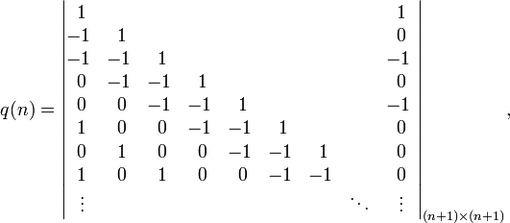
Function Expressions
Live Demo

Slide 19
Function Constructor
Function constructor is similar to expressions
A constructor initializes a function object
It is loaded when the parser reaches it
The function constructor form is:
Example
Not a good practice
Bad performance and messy code
new Function([optional arguments],body);
var printMsg = new Function("msg","console.log(msg);");
printMsg("Hello!");

Slide 20




Function Constructor
Live Demo

Slide 21
Function Expression vs. Function Declaration
Function declarations are loaded first, while function expressions are loaded when reached
i.e. function declarations can be used before they are declared, while expressions cannot
Function declarations can be overridden
Imagine two function declarations in the same scope have the same name
Which will be the one to execute?

Slide 22
Function Expression vs. Function Declaration (2)
Function declarations can be overridden
Results with unexpected behavior
if(true){
function printMsg(msg) {
console.log("Message (from if): " + msg);
}
}
else{
function printMsg(msg) {
console.log("Message (from else): " + msg);
}
}
printMsg("message");

Slide 23
Function Expression vs. Function Declaration (2)
Function declarations can be overridden
Results with unexpected behavior
if(true){
function printMsg(msg) {
console.log("Message (from if): " + msg);
}
}
else{
function printMsg(msg) {
console.log("Message (from else): " + msg);
}
}
printMsg("message");
logs (from else) in Opera, IE and Chrome

Slide 24
Function Expression vs. Function Declaration (2)
Function declarations can be overridden
Results with unexpected behavior
if(true){
function printMsg(msg) {
console.log("Message (from if): " + msg);
}
}
else{
function printMsg(msg) {
console.log("Message (from else): " + msg);
}
}
printMsg("message");
logs (from if) only in Firefox
logs (from else) in Opera, IE and Chrome

Slide 25
Function Expression vs. Function Declaration (3)
Easy to fix with function expression:
Works well on all browsers
if(true){
var printMsg = function (msg) {
console.log("--from if");
console.log(msg);
}
}
else{
var printMsg = function (msg) {
console.log("--from else");
console.log(msg);
}
}
printMsg("message");

Slide 26
Function Expression vs. Function Declaration (3)
Easy to fix with function expression:
Works well on all browsers
if(true){
var printMsg = function (msg) {
console.log("--from if");
console.log(msg);
}
}
else{
var printMsg = function (msg) {
console.log("--from else");
console.log(msg);
}
}
printMsg("message");
Logs ("from if") everywhere

Slide 27
Function Declaration vs. Function Expression
Live Demo

Slide 28
Function Properties
Values
Object
Methods

Slide 29
Function Properties
Each function is an object
Created either with declaration, expression or constructor
Functions have properties:
function.length
The count of parameters the function expects
The arguments object is not counted
function.name
Identifier of the function
Returns an empty string if anonymous

Slide 30
Function Methods

Slide 31
Function Methods
Functions have methods as well
function.toString()
Returns the code of the functions as a string
function.call(obj, args)
Calls the function over the obj with args
function.apply(obj, arrayOfArgs)
Applies the function over obj using the arrayOfArgs as arguments
Basically call and apply to the same
One gets args, the other gets array of args

Slide 32
Call and Apply
function.apply(obj, arrayOfargs) applies the function over an specified object, with specified array of arguments
Each function has a special object this
function.call(obj,arg1,arg2…) calls the function over an specified object, with specified arguments
The arguments are separated with commas
Apply and call do the same with difference in the way they receive arguments

Slide 33
Call and Apply
function.apply(obj, arrayOfargs) applies the function over an specified object, with specified array of arguments
Each function has a special object this
By invoking apply/call, obj is assigned to this
var numbers = […];
var max = Math.max.apply (null, numbers);
function printMsg(msg){
console.log("Message: " + msg);
}
printMsg.apply(null, ["Important message"]);
//here this is null, since it is not used anywhere in //the function
//more about this in OOP

Slide 34
Function Methods
Live Demo

Slide 35
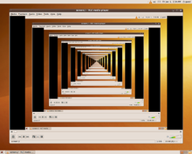
Recursion
Calling functions from themselves

Slide 36
Recursion
Functions can refer to themselves as call to themselves
This is called recursion
Example:
function factorial(n){
if(n==0){
return 1;
}
return factorial(n-1) * n;
}

Slide 37
Recursion
Functions can refer to themselves as call to themselves
This is called recursion
Example:
Bottom of the recursion. A recursion must always have a bottom!
function factorial(n){
if(n === 0){
return 1;
}
return factorial(n-1) * n;
}

Slide 38
Recursion (2)
Recursion works quite well when:
Traversing data structures
Trees, matrices, graphs, DOM nodes
Generating combinations
Generating sequences
Fibonacci, factorial
Every recursion can be replaced by enough loops, and form the so called iterative solution
Yet, in some cases using recursion is much simpler than using loops

Slide 39
Recursion: Factorial
Using recursion to calculate factorial numbers
Using the formula F(N) = F(N-1) * N
function factorial(n){
if(n === 0){
return 1;
}
return factoriel(n-1) * n;
}
console.log(factorial(5)); //120
console.log(factorial(12)); //479001600

Slide 40
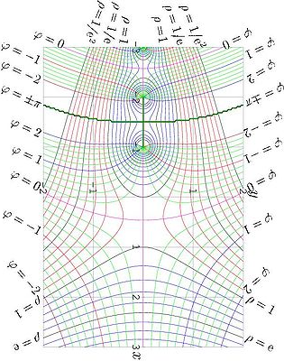
Factorial
Live Demo

Slide 41
Traversing the DOM
Passing a root element
Each element print its tag name and invokes the same function for each of its children
function traverse(element) {
function traverseElement(element, spacing) {
spacing = spacing || " ";
console.log(spacing + element.nodeName);
var len = element.childNodes.length;
for (var i = 0; i < len; i += 1) {
var child = element.childNodes[i];
if (child.nodeType === 1) {
traverseElement(child, spacing + "--");
}
}
console.log(spacing + "/" + element.nodeName);
}
traverseElement(element, "");
}

Slide 42
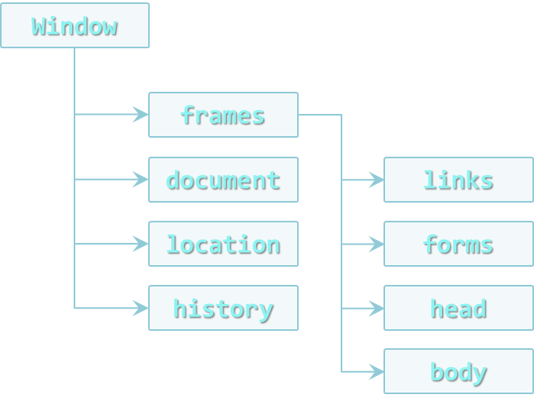
DOM Traversal
Live Demo

Slide 43
Recursion with Function Expression
Recursion is simple enough with function declarations
But not so easy with function expressions
var fact = function (n) {
if (n === 0) {
return 1;
}
return n * fact (n - 1);
};

Slide 44

Recursion with Function Expression
Recursion is simple enough with function declarations
But not so easy with function expressions
var fact = function (n) {
if (n === 0) {
return 1;
}
return n * fact (n - 1);
};
fact(5);
Logs 120

Slide 45
Recursion with Function Expression
Recursion is simple enough with function declarations
But not so easy with function expressions
var fact = function (n) {
if (n === 0) {
return 1;
}
return n * fact (n - 1);
};
fact(5);
var f = fact;
f(5);
Assign the function to a variable
Still logs 120

Slide 46

Recursion with Function Expression
Recursion is simple enough with function declarations
But not so easy with function expressions
var fact = function (n) {
if (n === 0) {
return 1;
}
return n * fact (n - 1);
};
fact(5);
var f = fact;
f(5);
fact = 5;
f(5);
Assign a number value to the original function
Throws TypeError (Number is not a function)

Slide 47
Buggy Recursion with Function Expressions
Live Demo

Slide 48
Recursion with Function Expression (2)
The previous example can be solved by giving an identifier to the function expression
Only the function itself can use this identifier
var factorial = function factorial(n) {
if (n == 1) {
return 1;
}
return n * factorial (n - 1);
//or use arguments.callee
};
var factorial2 = factorial;
factorial = 5;
console.log(factorial2(5)); //logs 120 - correct

Slide 49
Working Recursion With Function Expressions
Live Demo

Slide 50

Scope

Slide 51
Scope
Scope is a place where variables are defined and can be accessed
JavaScript has only two types of scopes
Global scope and function scope
Global scope is the same for the whole web page
Function scope is different for every function
Everything outside of a function scope is inside of the global scope
if(true){
var sum = 1+2;
}
console.log(sum);

Slide 52
Scope
Scope is a place where variables are defined and can be accessed
JavaScript has only two types of scopes
Global scope and function scope
Global scope is the same for the whole web page
Function scope is different for every function
Everything outside of a function scope is inside of the global scope
if(true){
var sum = 1+2;
}
console.log(sum);
The scope of the if is the global scope. sum is accessible from everywhere
The scope of the if is the global scope. sum is accessible from everywhere

Slide 53
Global Scope
The global scope is the scope of the web page
Objects belong to the global scope if:
They are define outside of a function scope
They are defined without var
Fixable with 'use strict'
function arrJoin(arr, separator) {
separator = separator || "";
arr = arr || [];
arrString = "";
for (var i = 0; i < arr.length; i += 1) {
arrString += arr[i];
if (i < arr.length - 1) arrString += separator;
}
return arrString;
}

Slide 54
Global Scope
The global scope is the scope of the web page
Objects belong to the global scope if:
They are define outside of a function scope
They are defined without var
Fixable with 'use strict'
function arrJoin(arr, separator) {
separator = separator || "";
arr = arr || [];
arrString = "";
for (var i = 0; i < arr.length; i += 1) {
arrString += arr[i];
if (i < arr.length - 1) arrString += separator;
}
return arrString;
}
arr, separator and i belong to the scope of printArr

Slide 55
Global Scope
The global scope is the scope of the web page
Objects belong to the global scope if:
They are define outside of a function scope
They are defined without var
Fixable with 'use strict'
function arrJoin(arr, separator) {
separator = separator || "";
arr = arr || [];
arrString = "";
for (var i = 0; i < arr.length; i += 1) {
arrString += arr[i];
if (i < arr.length - 1) arrString += separator;
}
return arrString;
}
arr, separator and i belong to the scope of printArr
arrString and arrJoin belong to the global scope

Slide 56
Global Scope (2)
The global scope is one of the very worst parts of JavaScript
Every object pollutes the global scope, making itself more visible
If two objects with the same identifier appear, the first one will be overridden

Slide 57

Global Scope
Live Demo

Slide 58
Function Scope
JavaScript does not have a block scope like other programming languages (C#, Java, C++)
{ and } does not create a scope!
Yet, JavaScript has a function scope
Function expressions create scope
Function declarations create scope
if(true)var result = 5;
console.log(result);//logs 5
if(true) (function(){ var result = 5;})();
console.log(result);//ReferenceError
function logResult(){ var result = 5; }
if(true) logResult();
console.log(result); //ReferenceError

Slide 59
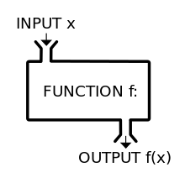
Function Scope
Live Demo

Slide 60
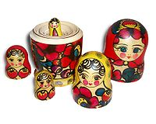
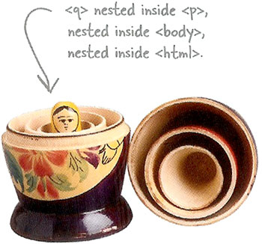
Nested Functions

Slide 61
Nested Functions
Functions in JavaScript can be nested
No limitation of the level of nesting
﻿function compare(str1, str2, caseSensitive) {
if(caseSensitive)
return compareCaseSensitive(str1,str2)
else
return compareCaseInsesitive(str1,str2);
function compareCaseSensitive(str1, str2) { … }
function compareCaseInsesitive(str1, str2) { … }
}

Slide 62
Nested Functions (2)
Which function has access to which objects and arguments?
It's all about scope!
Objects can access the scope they are in
And objects in the scope they are in can access the scope where they are in, and so on…
Also called closure
The innermost scope can access everything above it
function compare(str1, str2, caseSensitive) {
if(caseSensitive) return compareCaseSensitive(str1,str2)
else return compareCaseInsesitive(str1,str2);
function compareCaseSensitive(str1, str2) { … }
function compareCaseInsesitive(str1, str2) { … }
}

Slide 63
Nested Functions: Example
Objects can access the scope they are in
outer() can access the global scope
inner1() can access the scope of outer() and through it the global scope and etc…
﻿var str = "string"; //global
function outer(o1, o2) { //outer
function inner1(i1, i2, i3) { //inner1
function innerMost(im1) { //innerMost
…
} //end of innerMost
} //end of inner1
function inner2(i1, i2, i3) { //inner2
…
} //end of inner2
} //end of outer
//global

Slide 64
Nested Functions (3)
What about objects with the same name?
If in the same scope – the bottommost object
If not in the same scope – the object in the innermost scope
function compare(str1, str2, caseSensitive) {
if(caseSensitive) return compareCaseSensitive(str1,str2)
else return compareCaseInsesitive(str1,str2);
function compareCaseSensitive(str1, str2) {
//here matter str1 and str2 in compareCaseSensitive
}
function compareCaseInsesitive(str1, str2) {
//here matter str1 and str2 in compareCaseInsensitive
}
}

Slide 65
Nested Functions
Live Demo

Slide 66
Immediately Invoked Function Expressions
Functions invoked immediately after they are created

Slide 67
Immediately Invoked Function Expressions
In JavaScript, functions expressions can be invoked immediately after they are defined
Can be anonymous
Create a function scope
Don't pollute the global scope
Handle objects with the same identifier
IIFE must be always an expression
Otherwise the browsers don't know what to do with the declaration

Slide 68
Valid IIFE
Valid IIFEs
var iife = function(){ console.log("invoked!"); }();
(function(){ console.log("invoked!"); }());
(function(){ console.log("invoked!"); })();
!function(){ console.log("invoked!"); }();
true && function(){console.log("invoked!"); }();
1 + function(){console.log("invoked!"); }();
In all cases the browser must be explicitly told that the thing before () is an expression
IIFEs are primary used to create function scope
And prevent naming collisions

Slide 69
Immediately Invoked Function Expressions
Live Demo

Slide 70
Closures

Slide 71
Closures
Closures are a special kind of structure
They combine a function and the context of this function
function outer(x){
function inner(y){
return x + " " + y;
}
return inner;
}

Slide 72
Closures
Closures are a special kind of structure
They combine a function and the context of this function
function outer(x){
function inner(y){
return x + " " + y;
}
return inner;
}
inner() forms a closure. It holds a reference to x

Slide 73
Closures
Closures are a special kind of structure
They combine a function and the context of this function
function outer(x){
function inner(y){
return x + " " + y;
}
return inner;
}
inner() forms a closure. It holds a reference to x
In the context of f1, x has value 5
var f1 = outer(5);
console.log(f1(7)); //outputs 5 7

Slide 74
Closures
Closures are a special kind of structure
They combine a function and the context of this function
function outer(x){
function inner(y){
return x + " " + y;
}
return inner;
}
inner() forms a closure. It holds a reference to x
In the context of f1, x has value 5
var f1 = outer(5);
console.log(f1(7)); //outputs 5 7
In the context of f2, x has value "Peter"
var f2 = outer("Peter");
console.log(f2("Petrov")); //outputs Peter Petrov

Slide 75
Simple Closures
Live Demo

Slide 76
Closures Usage
Closures can be used for data hiding
Make objects invisible to their user
Make them private
var school = (function() {
var students = [];
var teachers = [];
function addStudent(name, grade) {...}
function addTeacher(name, speciality) {...}
function getTeachers(speciality) {...}
function getStudents(grade) {...}
return {
addStudent: addStudent,
addTeacher: addTeacher,
getTeachers: getTeachers,
getStudents: getStudents
};
})();

Slide 77
Closures Usage
Closures can be used for data hiding
Make objects invisible to the outside
Make them private
var school = (function() {
var students = [];
var teachers = [];
function addStudent(name, grade) {...}
function addTeacher(name, speciality) {...}
function getTeachers(speciality) {...}
function getStudents(grade) {...}
return {
addStudent: addStudent,
addTeacher: addTeacher,
getTeachers: getTeachers,
getStudents: getStudents
};
})();
This is actually called a Module

Slide 78
Closures
Live Demo

Slide 79
Advanced Function
http://academy.telerik.com

Slide 80
Homework
Create a module for working with DOM. The module should have the following functionality
Add DOM element to parent element given by selector
Remove element from the DOM by given selector
Attach event to given selector by given event type and event hander
Add elements to buffer, which appends them to the DOM when their count for some selector becomes 100
The buffer contains elements for each selector it gets
Get elements by CSS selector
The module should reveal only the methods

Slide 81
Homework (2)
(cont. ) Create a module for working with DOM. The module should have the following functionality
var domModule = …
var div = document.createElement("div");
//appends div to #wrapper
domModule.appendChild(div,"#wrapper");
//removes li:first-child from ul
domModule.removeChild("ul","li:first-child");
//add handler to each a element with class button
domModule.addHandler("a.button", 'click',
function(){alert("Clicked")});
domModule.appendToBuffer("container", div.cloneNode(true));
domModule.appendToBuffer("#main-nav ul", navItem);

Slide 82
Homework (3)
Create a module that works with moving div nodes. Implement functionality for:
Add new moving div element to the DOM
The module should generate random background, font and border colors for the div element
All the div elements are with the same width and height
The movements of the div nodes can be either circular or rectangular
The elements should be moving all the time
var movingShapes = …
//add element with rectangular movement
movingShapes.add("rect");
//add element with ellipse movement
movingShapes.add("ellipse");

Slide 83
Homework (4)
Create a module to work with the console object. Implement functionality for:
Writing a line to the console
Writing a line to the console using a format
Writing to the console should call toString() to each element
Writing errors and warnings to the console with and without format
var specialConsole = …
specialConsole.writeLine("Message: hello");
//logs to the console "Message: hello"
specialConsole.writeLine("Message: {0}", "hello");
//logs to the console "Message: hello"
specialConsole.writeError("Error: {0}", "Something happened");
specialConsole.writeWarning("Warning: {0}", "A warning");

